Slide 1
FOOD DELIVERY SYSTEM
Guide – Prof. Sreesh Gaur
Team Members – Pallav Kumar (1900290120074)
Yatin Kumar Singh(1900290120133)
Prashant Gupta(1900290120079)

Slide 2
INTRODUCTION
The online food ordering system is one of the latest servicers most fast-food restaurants in the western world are adopting. With this method, food is ordered online and delivered to the customer. This is made possible through the use of an electronic payment system. Customers pay with their credit cards, although credit card customers can be served even before they make payment either through cash or cheque. So, the system designed in this project will enable customers to go on And place an order for their food. Due to the great increase in the awareness of the internet and the technologies associated with it, several opportunities are coming up on the web. So many businesses and companies now venture into their business with ease because of the internet. One of such businesses that the internet introduced is an online food ordering system. In today‘s age of fast food and take-out, many restaurants have chosen to focus on quick preparation and speedy delivery of orders rather than offering a rich dining experience. Until recently, most of these delivery orders were placed over the phone, but there are many disadvantages to this system. Anybody can order any goods via the internet and have the goods delivered at his/her doorsteps. But while trying to discuss the transfer method of the goods and services, attention is focused on the payment mode. In other words, how possible is it to pay for goods and services via the internet? This then leads to the discussion of the economic consequences of digital cash. What are the implementations from the viewpoint of economics? Since the world is fast becoming a global village, the necessary tool for this process is communication of which telecommunication is a key player. A breakthrough is the wireless 2 telephone system which comes in either fixed wireless telephone lines or the Global System of Mobile communication (GSM). This allows the restaurant employees to quickly go through the orders as they are placed and produce the necessary items with minimal delay and confusion. The greatest advantage of this system is its FLEXIBILITY.

Slide 3
LIST OBJECTIVE(s)
This study lays out a framework for a new system to be developed and brought to the market for maximum use and to create an avenue through the web where users can log on to our server and make a selection of whatever goods or food they like subsequently pay via the internet. The following are the objectives this would bring
1.The home page of this web interfile provides an avenue where customers will be able to gather more reliable information about what the fast-food industry does.
2. The products and services offered would provide the customers with all the different categories of available products that they can choose and select from.
3. This will provide a user-friendly environment between the customer and employee thus increasing the efficiency of the food ordering system.
4. There will also be an online purchase form with which valued customers will be using to get in touch with any of their requests whenever the need arises.
5. It will also help for easy retrieval of orders made by the customers

Slide 4
LITERATURE SURVEY

Slide 5
1. Online food delivery System
Online food is mainly designed for the use in the food delivery industry. This system allows hotel and restaurants to increase online food ordering such a type of business.The customers can select food menu items in just a few minutes. The modern food industry allows to quickly and easily delivery on customer place. Restaurant employees then use these orders through an easy to deliver on customer place easy find out navigate graphical interface for efficient processing. There are various advantages of using food delivery websites such as quick delivery, easy and conventional way to order food when stucked somewhere in traffic etc. whereas some disadvantages include extra charges for the delivery etc.

Slide 6
2. Food Ordering Web Application for the Fitness freaks
The online food ordering system provides convenience for the customers. It overcomes the disadvantages of the traditional queuing system. This system increases the takeaway of foods than visitors .Therefore, this system enhances the speed and standardization of taking orders from the customer. It provides a better communication platform. the user’s details are noted electronically. The online food ordering system sets up a menu online and the customers easily place the order with a simple mouse click. also with a food menu online you can easily track the orders, maintain customer databases and improve your food delivery service.This system allows the user to select the desired food items from the displayed menu. The user orders the food items. The payment can be made online or pay-on delivery system. The user’s details are maintained confidential because it maintains a separate account for each user. An id and password are provided for each user. Therefore, it provides a more secured ordering.

Slide 7
3. Comparative analysis of MEAN stack and MERN stack
Most of today’s world web applications are designed using a ‘stack’ of various technologies. Mean stack and mern stack are two of the most popular and extremely powerful stacks that are used for the development of modern web applications.mern stands for mongodb, expressjs, reactjs, and nodejs, and mean being for mongodb, expressjs, angularjs, and nodejs. The key factor is that both the stacks ushers under a single umbrella named javascript. This ensures faster development and helps developers quickly get products to market as the need of understanding different languages to contribute to both the front-end and back-end gets eliminated, and eventually leads to a huge cut in development costs and improves efficiency. This paper revolves around analyzing features, advantages, and disadvantages of the two stack and also throws light upon the key factors that play a major role during the selection of one out of the former two.

Slide 8
4. A comparative study between the mysql Vs. Mongodb as back-end for online platform
In this article we present a comparative study between the usage capabilities of MongoDB, a non-relational database, and MySQL‘s usage capabilities, a relational database, as a back-end for an online platform. We will also present the advantages of using a non-relational database, namely MongoDB, compared to a relational database, namely MySQL, integrated in an online platform, which allows users to publish different articles, books, magazines and so on, and also gives them the possibility to share online their items with other people. Nowadays, most applications have thousands of users that perform operations simultaneously thus, it takes more than one operation to be executed at a time, to really see the differences between the two databases. This paper aims to highlight the differences between MySQL and MongoDB, integrated in an online platform, when various operations were executed in parallel by many users.

Slide 9
5. Comparative analysis of MEAN stack and MERN stack
Most of today‘s world web applications are designed using a ‗stack‘ of various technologies. MEAN stack and MERN stack are two of the most popular and extremely powerful stacks that are used for the development of modern web applications. MERN stands for MongoDB, ExpressJS, ReactJS, and NodeJS, and MEAN being for MongoDB, ExpressJS, AngularJS, and NodeJS. The key factor is that both the stacks ushers under a single umbrella named JavaScript. This ensures faster development and helps developers quickly get products to market as the need of understanding different languages to contribute to both the front-end and back-end gets eliminated, and eventually leads to a huge cut in development costs and improves efficiency. This paper revolves around analyzing features, advantages, and disadvantages of the two stack and also throws light upon the key factors that play a major role during the selection of one out of the former two.

Slide 10
6. Understanding the experience and meaning of app-based food delivery from a mobility perspective
Online food delivery service has developed rapidly and expanded the boundaries of the catering industry. Being a food delivery rider in the gig economy attracts workers with the premises of flexibility and freedom. However, existing studies based on labor process theory revealed that freedom is fictitious. The study sheds light on how the individual rider finds meaning in their work from the mobility perspective. A mixed-method approach based on questionnaires, interviews, and mobile ethnography is applied. Findings showed that food delivery riders gain the experience of freedom in many aspects, from flexible working hours, body movement, immediate cash transfer to freedom from many other regulations. Being a rider represents a free lifestyle and a way to control one‘s fate. Yet, it is perceived as a transitional job. This study contributes to making connections between the mobility perspective and work-related studies.

Slide 11
7. Comparative Analysis on Front-End Frameworks for Web Applications
An essential step in developing any program or app is choosing the appropriate front-end framework or library. Frontend Web development sounds similar to the JavaScript framework. Both of these choices are available for web development requirements. Vue, React, and Angular all fall under the umbrella of JavaScript frameworks. Due to the extensive spectrum of issues developers encounter daily, the industry offers a wide diversity. With the help of many accessible frameworks, a web application may be constructed as intended while considering all practical considerations. The advantages and disadvantages of the fundamental elements and distinctive features of frameworks are discussed in this paper. Additionally, it offers a thorough analysis of the research on front-end frameworks. This study gives an overview of the front-end frameworks discovered in the literature, outlining the essential components of these frameworks using a systematic literature review as methodology. The three most popular frameworks, Vue.js, Angular, and React, were examined for the necessary features

Slide 12
Flowchart

Slide 13
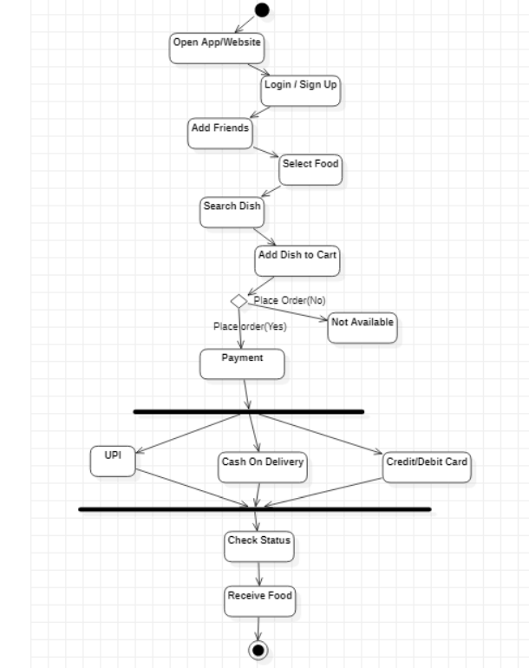
Activity Diagram

Slide 14
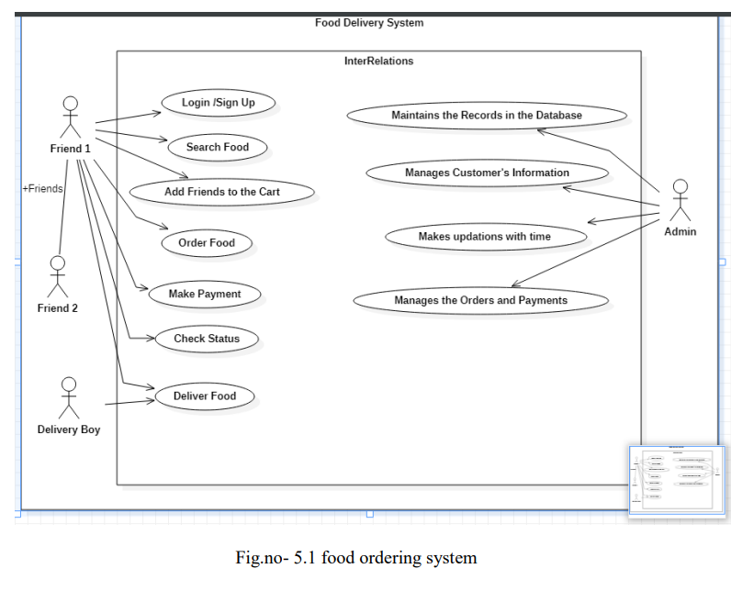
UseCase Diagram

Slide 15
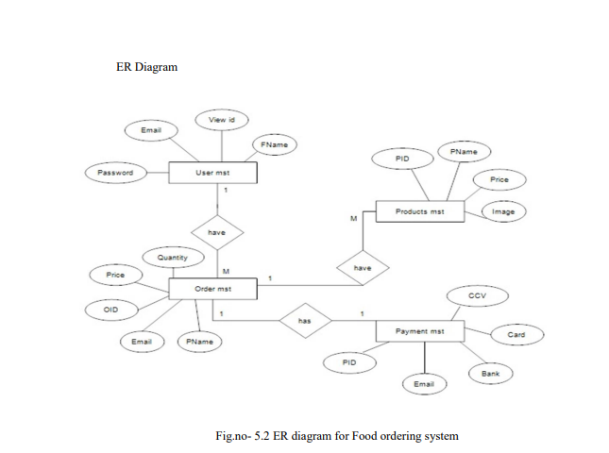
ER- DIAGRAM

Slide 16
TECHNOLOGY USED
MERN Stack:
MERN stack is a web development framework. It consists of MongoDB, ExpressJS, ReactJS, and NodeJS as its working Components. Here are the details of what each of these components is used for in developing a web application when using MERN Stack.
MongoDB: A document-oriented, No-SQL database used to store the application data.
NodeJS: The JavaScript runtime environment. It is used to run JavaScript on a machine rather than in a browser.
ExpressJS: A framework layered on top of NodeJS used to build the backend of a site using NodeJS functions and structures. Since NodeJS was not developed to make websites but rather to run Java Script on a machine, ExpressJS was developed.
ReactJS: A library created by Facebook. It is used to build UI Components that create the user interface of the single-page Web Application.

Slide 17
MERITS AND DEMERITS OF FOOD WEBSITES
Merits
Demerits
Makes managing order simpler
Improves productivity
Keep track of orders and deliveries
Increase sales and revenue
Manage business on single platform
Enables to add food in the same cart by more than one user
Data Security
Risk of losing customer data
Technical Issues

Slide 18
CONCLUSION
Therefore, the conclusion of the proposed system is based on the user‘s needs and is user-centered. The system is developed in considering all issues related to all users which are included in this system. A wide range of people can use this if they know how to operate on the smartphone. Various issues related to Mess/Tiffin Service will be solved by providing them full-fledged system. Thus, the implementation of the Online Food Ordering system is done to help and solve one of the important problems of people. Based on the result of this research, it can be concluded: It helps customers in making orders easily; It gives information needed in making an order to the customer. The Food website application made for restaurants and mess can help restaurant and mess in receiving orders and modifying its data and it is also made for admin so that it helps admin in controlling all the Food system. With an online food ordering system, a restaurant and mess menu online can be set up and the customers can easily place an order. Also with a food menu online, tracking the orders is done easily, it maintains customer‘s database and improves the food delivery service. The restaurants and mess can even customize the online restaurant menu and upload images easily. Having a restaurant menu on the internet, potential customers can easily access it and place an order at their convenience

Slide 19
THANK YOU

